Slide 1
Sales Order and invoicing – desktop program
Jian Zhao
Dongfan Zhang

Slide 2
Background
From existing sales orders stored in database, enable user to issue the invoices for chosen sales orders.
Once invoice is issued, it will be stored into database, and corresponding order status will be changed to complete.

Slide 3
functions need to be implemented-what user can do - part
Query Sales orders
Query Invoices
Issue invoices
export invoice to csv.
export invoice to PDF.
Export invoice and email as attachment

Slide 4
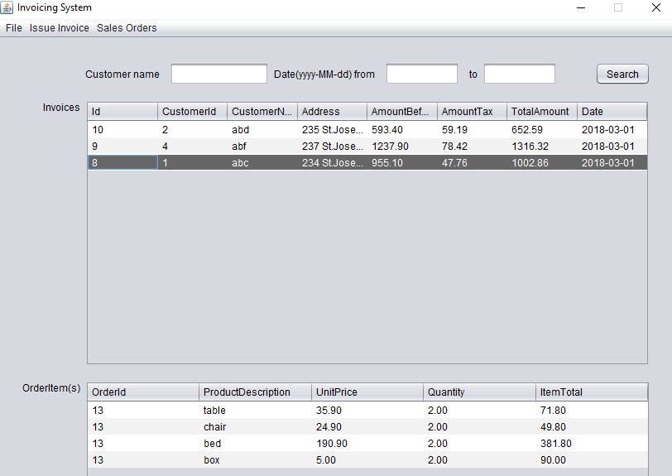
Solution overview – main window showing invoices and invoice details also has different query criteria

Slide 5
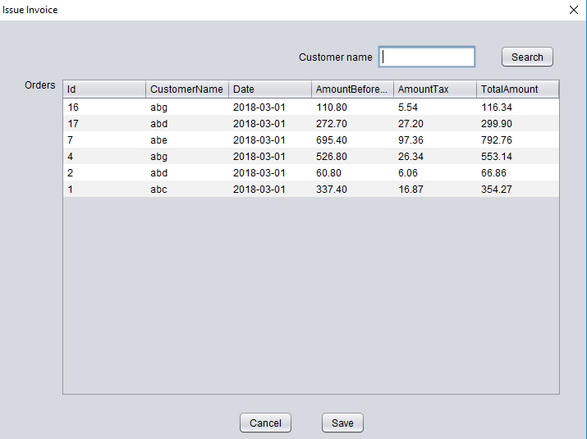
Issue invoices

Slide 6
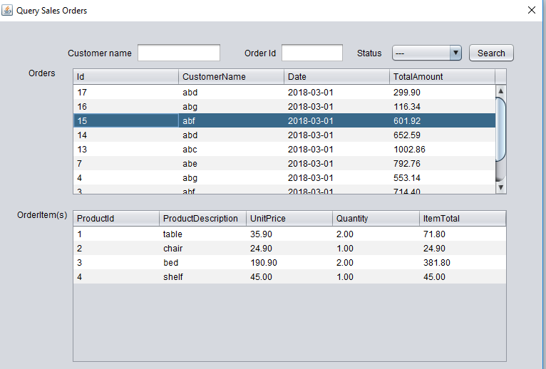
Sales orders query

Slide 7
Challenges and solution
Database design
Mapping the database designs (relational tables into java entity classes) by using composition/aggregation concepts
Write the DAO (data access object) according to program requirements
Working with Collections
Find out how to export invoice as PDF
Find out how to send emails via java

Slide 8
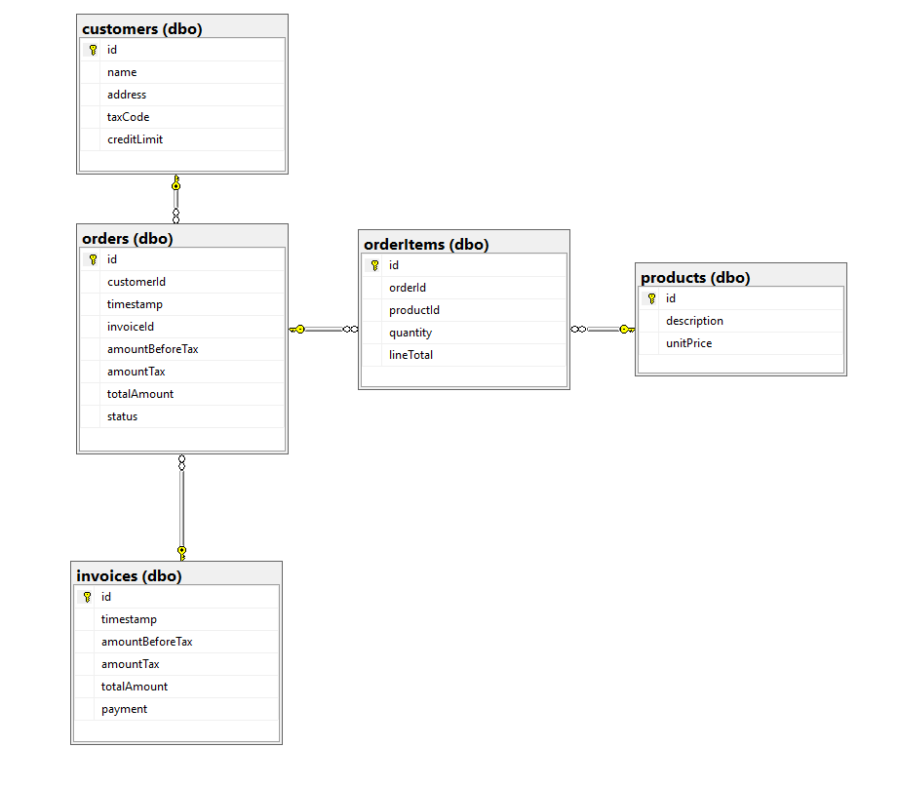
Database design – 5 tables

Slide 9
Tables mapping to java entity classes
Every table is turned into one entity class with their own attributes/ fields plus some composition/aggregation from other classes
Table Customers ➔ java Class Customer nothing special
Table products ➔ java Class Product nothing special
Table orderItems ➔ java Class OrderItem object Product for field product
Table orders ➔ java Class SalesOrder object Customer for field customer, object Invoice for field invoice and list of orderItems for field items
Table invoice ➔ java Class Invoice Customer for customer, list of SalesOrder for salesOrder
Those objects or list of object as fields, my understanding is composition/aggregation

Slide 10
Java class code sample
public class SalesOrder {
private int id;
private int customerId;
private java.sql.Date timestamp;
private BigDecimal amountBeforeTax;
private BigDecimal amountTax;
private BigDecimal totalAmount;
private OrderStatus status;
private List<OrderItem> items;
private Invoice invoice;
private Customer customer;
Public class Invoice {
private int id;
private java.sql.Date timestamp;
private BigDecimal amountBeforeTax;
private BigDecimal amountTax;
private BigDecimal totalAmount;
private BigDecimal payment;
private List <SalesOrder> salesOrder;
private Customer customer;

Slide 11
DAO (DATABASE class)
Using database connection transaction ensure the data integrity for issuing invoice (insert record into invoices table, meanwhile modify status to "complete" for orders through update orders table)
Overload getOrders method for adapting different search functionality
Using StringBulider instead of String for concatenation sql statements, which are easier readable and more elegant
public List<SalesOrder> getOrders() throws SQLException{
return getOrders("", 0, "", 0);
}
public List<SalesOrder> getOrdersByCustomerName(String customerName) throws SQLException{
return getOrders(customerName, 0, "", 0);
}
public List<SalesOrder> getOrders(String customerName, String status) throws SQLException{
return getOrders(customerName, 0, status, 0);
}

Slide 12
Working with Collections
In our case, one invoice has one or several sales orders and one sales order can have multiple items. This often results to manipulate data collections.
Sample code as below:
List<Invoice> invoices = db.getInvoices(txtCustomerName.getText(), dateFrom, dateTo);
for (Invoice invoice : invoices) {
modelInvoices.addRow(new Object[]{
invoice.getId(),
invoice.getCustomer().getId(), invoice.getCustomer().getName(), invoice.getCustomer().getAddress(),
invoice.getAmountBeforeTax(), invoice.getAmountTax(), invoice.getTotalAmount(), df.format(invoice.getTimestamp())
});
}

Slide 13
Export to PDF
Using open source iText library for java
Using rectangle to implement block control for positioning paragraph text
Using table to display order items of invoices

Slide 14
Email with attachment using gmail
Using library activation.jar and javax.mail.jar, we can realise the function of sending email with attachment using Gmail server.
When user click export and send email. Program will first save csv to predefined folder then fetch the email address from database through customers table.
We write a separate email class with send method to wrap up all the code for email, in the main code class we just need to pass the arguments to the send method to realize the function

Slide 15
private void miExCSVEmailActionPerformed(java.awt.event.ActionEvent evt) {
exportCSV();
String email = ""; String fileName = "";
String filePath = new File("").getAbsolutePath() + "\\export_invoices\\csv\\";
final String user = "zdfmontreal13@gmail.com";
final String password = "zoe20178";
try {
Object invoiceId = modelInvoices.getValueAt(jtInvoices.getSelectedRow(), 0);
Invoice invoice = db.getInvoiceById(Integer.parseInt(invoiceId.toString()));
email = invoice.getCustomer().getEmail();
fileName = "invoice_" + invoice.getCustomer().getName() + "_" + invoiceId.toString() + ".csv";
} catch (SQLException ex) {
Logger.getLogger(MainFrameInvoice.class.getName()).log(Level.SEVERE, null, ex); }
System.out.println(email);
MailWithAttachment.send(user, password, email, "invoice", "please check invoice", filePath + fileName, fileName);
}

Slide 16
Future improvements
Add user log in interface when the program starts
Add different users roles like order entry, invoice issue, all right etc.
Add Sales orders management (create new order, update order, delete order)

Slide 17
Summary
Implemented all the functionality planned for the project

